Slide 1
Capital Improvement Program
FY2013/14-2017/18
August 23rd, 2012

Slide 2
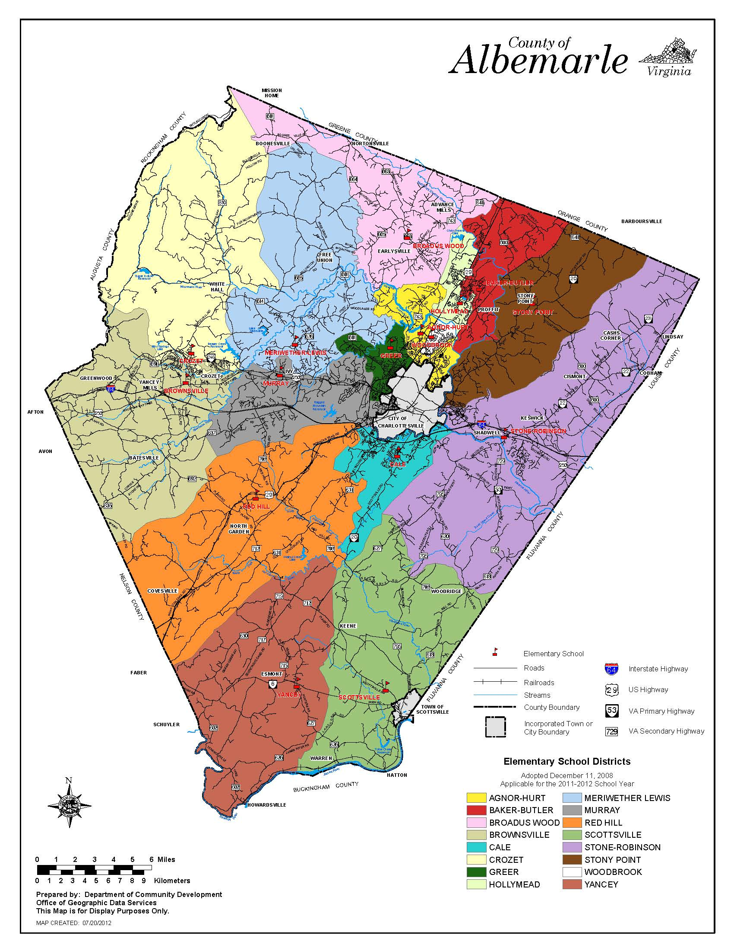
    REDISTRICTING
    The LRPAC’s final report recommended that a redistricting committee evaluate Agnor-Hurt Elementary & Meriwether Lewis Elementary.
    The LRPAC recommend changes be enacted as soon as the 2013/14 school year.
    Per policy, the School Board must direct the Superintendent to form a redistricting advisory committee in order for any redistricting to occur.
Capital Improvement Program FY13/14-17/18 August 23rd, 2012

Slide 3

    REDISTRICTING
    Agnor-Hurt Elementary
    The school is projected to be almost 40% over capacity in 5 years:
    Building Capacity: 464
    2011/12 Enrollment: 575 (+111 over capacity)
    Projected 5 year Enrollment: 648 (+184 over capacity)
    Trailers: 3 (including one moved there this summer)
    Pre-K program had to be moved to Woodbrook for 2012/13 School Year
    New Developments in the vicinity:
        Stonefield, 250 Units (Greer),
        Arden Place, 212 Units (Woodbrook)
        Treesdale, 88 Units (Agnor-Hurt)
        Reserve at Belvedere, 294 units (Agnor-Hurt)
Capital Improvement Program FY13/14-17/18 August 23rd, 2012

Slide 4
    REDISTRICTING
    Agnor-Hurt Elementary
BWE
    Northern Elementary Schools:
SCHOOL | CAPACITY CONFLICTS
 | 11/12 | 12/13 | 13/14 | 14/15 | 15/16 | 16/17
AGNOR HURT | (111) | (124) | (150) | (163) | (175) | (184)
BROADUS WOOD* | 100 | 87 | 87 | 86 | 77 | 77
GREER** | 114 | 102 | 97 | 90 | 94 | 83
WOODBROOK | 5 | (8) | (11) | (14) | (17) | (29)
Subtotal | 108 | 57 | 23 | (1) | (21) | (53)
AGH
WDB
GRE
Capital Improvement Program FY13/14-17/18 August 23rd, 2012

Slide 5
    REDISTRICTING
    Agnor-Hurt Elementary
    *Broadus Wood
      School is also a redistricting option for Meriwether Lewis.
      Geography & roads do not provide a perfect solution where all 77 seats could be occupied by current AGH students without substantially increasing their bus ride.
    **Greer
      School’s population is a deterrence to filling this school to full capacity. With the highest free and reduced lunch rate in the division, the school has unique space and staffing needs.
BWE
AGH
WDB
GRE
Capital Improvement Program FY13/14-17/18 August 23rd, 2012

Slide 6
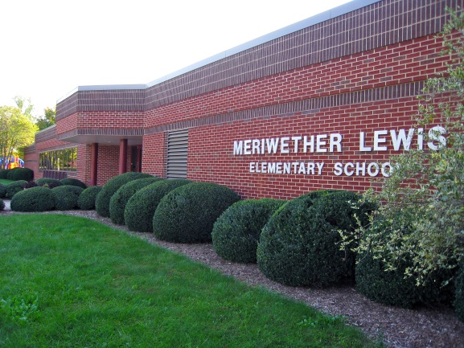
    REDISTRICTING
    Meriwether Lewis Elementary
    The school is projected to be over 25% over capacity in 5 years:
    Building Capacity: 380
    2011/12 Enrollment: 446 (+66 over capacity)
    Projected 5 year Enrollment: 477 (+97 over capacity)
    Trailers: 4 (including 1 moved this summer)
Capital Improvement Program FY13/14-17/18 August 23rd, 2012

Slide 7
    REDISTRICTING
    Meriwether Lewis
    Elementary
BWE
    Western Schools:
SCHOOL | CAPACITY CONFLICTS
 | 11/12 | 12/13 | 13/14 | 14/15 | 15/16 | 16/17
BROWNSVILLE | 107 | 92 | 70 | 32 | 28 | 31
CROZET | 54 | 54 | 50 | 50 | 39 | 41
MERIWETHER | (66) | (83) | (83) | (97) | (104) | (97)
MURRAY | 48 | 37 | 40 | 35 | 29 | 29
Subtotal | 143 | 100 | 77 | 20 | (8) | (4)
HENLEY | 124 | 130 | 94 | 93 | 62 | 22
WESTERN (HS) | 80 | 53 | 66 | 34 | (1) | (20)
CRO
MWL
BRN
MUR
REH
Capital Improvement Program FY13/14-17/18 August 23rd, 2012

Slide 8
    REDISTRICTING
    OPTION 1
    Convene a Single Redistricting Advisory Committee to evaluate Agnor-Hurt & Meriwether Lewis with representatives from: Agnor-Hurt, Meriwether Lewis, Broadus Wood, Greer, Crozet & Murray
    OPTION 2
    Convene two committees:
    A. A redistricting advisory committee to evaluate Agnor-Hurt with representatives from: Agnor-Hurt, Broadus Wood, & Greer
    B. A redistricting advisory committee to evaluate Western Feeder Pattern holistically including options to redistrict out of the feeder pattern all together (Murray or Brownsville to Red Hill). Representatives would be from Meriwether Lewis, Crozet, Brownsville, Murray & Red Hill.
Capital Improvement Program FY13/14-17/18 August 23rd, 2012

Slide 9
    CIP BUDGET
    At the last meeting, the Long Range Planning Advisory Committee presented a needs-based analysis totaling over $86 million for five years.
In April 2012, the Board of Supervisors approved $ 35,360,508 for schools in the FY2012/13-2016/17 Capital Improvement Program.
The CIP process is a two year planning cycle and we are in year 2 of the cycle:
  YEAR 2 typically involves only streamlined review of urgent or emergency project needs and update cost estimates for projects in the five-year window.
Capital Improvement Program FY13/14-17/18 August 23rd, 2012

Slide 10
LRPAC RECOMMENDED 5 YEAR CAPITAL PLAN
PROJECT |  |  | YEAR
RANK | School/Department | Description | 2013/14 | 2014/15 | 2015/16 | 2016/17 | 2017/18 | Subtotal
1 | Building Services | Maintenance | 4,477 | 4,899 | 4,755 | 5,288 | 5,812 | 25,231
2 | Technology | State Technology Grant | 752 | 752 | 752 | 752 | 752 | 3,760
3 | Technology | Instructional Technology | 575 | 575 | 575 | 650 | 650 | 3,025
4 | Technology | Administrative Technology | 183 | 261 | 261 | 261 | 263 | 1,229
5 | Technology | Telecom. Network Upgrade | 900 |  |  |  | 900 | 1,800
6 | Transportation | School Bus Replacement | 1,475 | 1,525 | 1,630 | 1,738 | 1,674 | 8,042
7 | Various | Storage Lease | 150 | 155 | 159 | 164 | 168 | 796
8 | Yancey | Purchase Land +Install Septic | 422 |  |  |  |  | 422
 |  | Roof & HVAC Maintenance | 661 | 424 |  |  |  | 1,085
 |  | Modernization + Addition | 426 | 4,866 |  |  |  | 5,292
9 | Murray High School | Phase 1: Renovations | 529 |  |  |  |  | 529
10 | Henley | Gym/Media Center & Large Group Space | 214 | 2,858 |  | 125 | 1,671 | 4,869
11 | Red Hill | Modernization + Remove Trailers | 440 | 4,864 |  |  |  | 5,304
12 | Future | Land for Northern Complex | 40 | 60 | 8,268 |  |  | 8,368
13 | Agnor-Hurt | Addition |  | 383 | 4,206 |  |  | 4,589
14 | Crozet | Addition |  |  | 462 | 5,364 |  | 5,826
15 | Stony Point | Addition |  |  | 159 | 1,884 |  | 2,043
16 | Various | Contemporary Learning Spaces | 250 | 250 | 250 | 250 | 250 | 1,250
17 | Western Albemarle | Kitchen Upgrades & Modernization |  | 24 | 244 | 171 | 1,753 | 2,192
TOTAL |  |  | 11,494 | 21,896 | 21,721 | 16,647 | 14,285 | 86,043

Slide 11
LRPAC RECOMMENDED 5 YEAR CAPITAL PLAN
Projects currently funded in the CIP as approved by the Board of Supervisors in April 2012.
PROJECT |  |  | YEAR
RANK | School/Department | Description | 2013/14 | 2014/15 | 2015/16 | 2016/17 | 2017/18 | Subtotal
1 | Building Services | Maintenance | 4,477 | 4,899 | 4,755 | 5,288 | 5,812 | 25,231
2 | Technology | State Technology Grant | 752 | 752 | 752 | 752 | 752 | 3,760
3 | Technology | Instructional Technology | 575 | 575 | 575 | 650 | 650 | 3,025
4 | Technology | Administrative Technology | 183 | 261 | 261 | 261 | 263 | 1,229
5 | Technology | Telecom. Network Upgrade | 900 |  |  |  | 900 | 1,800
6 | Transportation | School Bus Replacement | 1,475 | 1,525 | 1,630 | 1,738 | 1,674 | 8,042
7 | Various | Storage Lease | 150 | 155 | 159 | 164 | 168 | 796
8 | Yancey | Purchase Land +Install Septic | 422 |  |  |  |  | 422
 |  | Roof & HVAC Maintenance | 661 | 424 |  |  |  | 1,085
 |  | Modernization + Addition | 426 | 4,866 |  |  |  | 5,292
9 | Murray High School | Phase 1: Renovations | 529 |  |  |  |  | 529
10 | Henley | Gym/Media Center & Large Group Space | 214 | 2,858 |  | 125 | 1,671 | 4,869
11 | Red Hill | Modernization + Remove Trailers | 440 | 4,864 |  |  |  | 5,304
12 | Future | Land for Northern Complex | 40 | 60 | 8,268 |  |  | 8,368
13 | Agnor-Hurt | Addition |  | 383 | 4,206 |  |  | 4,589
14 | Crozet | Addition |  |  | 462 | 5,364 |  | 5,826
15 | Stony Point | Addition |  |  | 159 | 1,884 |  | 2,043
16 | Various | Contemporary Learning Spaces | 250 | 250 | 250 | 250 | 250 | 1,250
17 | Western Albemarle | Kitchen Upgrades & Modernization |  | 24 | 244 | 171 | 1,753 | 2,192
TOTAL |  |  | 11,494 | 21,896 | 21,721 | 16,647 | 14,285 | 86,043
*
**
*Specific project lists by year have been modified
**Approved as a part of the maintenance replacement program

Slide 12
LRPAC RECOMMENDED 5 YEAR CAPITAL PLAN
PROJECT |  |  | YEAR
RANK | School/Department | Description | 2013/14 | 2014/15 | 2015/16 | 2016/17 | 2017/18 | Subtotal
1 | Building Services | Maintenance | 4,477 | 4,899 | 4,755 | 5,288 | 5,812 | 25,231
2 | Technology | State Technology Grant | 752 | 752 | 752 | 752 | 752 | 3,760
3 | Technology | Instructional Technology | 575 | 575 | 575 | 650 | 650 | 3,025
4 | Technology | Administrative Technology | 183 | 261 | 261 | 261 | 263 | 1,229
5 | Technology | Telecom. Network Upgrade | 900 |  |  |  | 900 | 1,800
6 | Transportation | School Bus Replacement | 1,475 | 1,525 | 1,630 | 1,738 | 1,674 | 8,042
7 | Various | Storage Lease | 150 | 155 | 159 | 164 | 168 | 796
8 | Yancey | Purchase Land +Install Septic | 422 |  |  |  |  | 422
 |  | Roof & HVAC Maintenance | 661 | 424 |  |  |  | 1,085
 |  | Modernization + Addition | 426 | 4,866 |  |  |  | 5,292
9 | Murray High School | Phase 1: Renovations | 529 |  |  |  |  | 529
10 | Henley | Gym/Media Center & Large Group Space | 214 | 2,858 |  | 125 | 1,671 | 4,869
11 | Red Hill | Modernization + Remove Trailers | 440 | 4,864 |  |  |  | 5,304
12 | Future | Land for Northern Complex | 40 | 60 | 8,268 |  |  | 8,368
13 | Agnor-Hurt | Addition |  | 383 | 4,206 |  |  | 4,589
14 | Crozet | Addition |  |  | 462 | 5,364 |  | 5,826
15 | Stony Point | Addition |  |  | 159 | 1,884 |  | 2,043
16 | Various | Contemporary Learning Spaces | 250 | 250 | 250 | 250 | 250 | 1,250
17 | Western Albemarle | Kitchen Upgrades & Modernization |  | 24 | 244 | 171 | 1,753 | 2,192
TOTAL |  |  | 11,494 | 21,896 | 21,721 | 16,647 | 14,285 | 86,043
$51,073

Slide 13
    Multi-Year Projects
    Maintenance ($26, 738,000)
      Request includes Yancey’s Septic, Roof & HVAC Replacement
      Overall 5 year request has increased from last year
    State Technology Grant ($3,760,000), Instructional Technology ($3,025,000), Administrative Technology ($1,229,000)
      Same funding request as last year
    Telecommunications Network Upgrade ($1,800,000)
      Funding amount same as previous requests for Local Area Network & Wide Area Network combined
    School Bus Replacement ($8,042,000)
      NEW: Approved by School Board last year, but not Board of Supervisors (BOS)
    Storage Lease ($796,000)
      BOS only approved lease through 2013/14
Capital Improvement Program FY13/14-17/18 August 23rd, 2012

Slide 14
REMAINING PROJECTS: HOW TO SPEND $7 mil.
CAPACITY PROJECTS | PARITY PROJECTS | LEARNING SPACE PROJECTS
Agnor-Hurt Addition $4.5 m | Enterprise Renovation $0.5 m | Henley Gym Addition $2.25 m
Crozet Addition $5.5 m | Red Hill Modernization $5.25 m | Henley Media Center Expansion $0.75 m
Stony Point Addition $2.0 m | Yancey Modernization $2.0 m | Henley Large Group Meeting Space $1.75 m
Land for Future School $8.0 m | Yancey Addition $3.0 m | Contemporary Learning Spaces $0.25 m/year
 | WAHS Kitchen Upgrades $.25m
 | WAHS Modernization $2.0m

Slide 15
    Capacity Projects

Slide 16
    CAPACITY PROJECTS
    Agnor-Hurt Elementary
    Issue:
    The school is projected to be almost 40% over capacity in 5 years:
    Building Capacity: 464
    2011/12 Enrollment: 575 (+111 over capacity)
    Projected 5 year Enrollment: 648 (+184 over capacity)
    Trailers: 3
    Solution:
    Redistrict students for 2013/14 school year AND construct an addition in the next five years.
    Estimated Cost: $4,459,000
Capital Improvement Program FY13/14-17/18 August 23rd, 2012

Slide 17
    CAPACITY PROJECTS
    Meriwether Lewis Elementary
    (Western Feeder Pattern Growth)
    Issue:
    The school is projected to be over 25% over capacity in 5 years:
    Building Capacity: 380
    2011/12 Enrollment: 446 (+66 over capacity)
    Projected 5 year Enrollment: 477 (+97 over capacity)
    Trailers: 4
    Solution:
    Redistrict students for 2013/14 school year AND construct an addition onto Crozet Elementary in the next five years. Crozet ES is on public water & is in a designated growth area.
    Estimated Cost: $5,665,000
Capital Improvement Program FY13/14-17/18 August 23rd, 2012

Slide 18
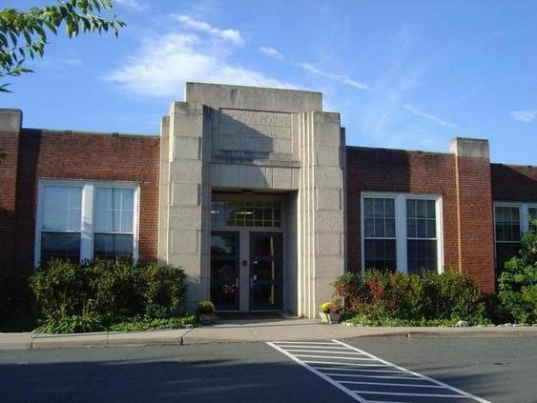
    CAPACITY PROJECTS
    Stony Point Elementary
    Issue:
    The school is projected to be over 50% over capacity in 5 years:
    Building Capacity: 225
    2011/12 Enrollment: 286 (+61 over capacity)
    Projected 5 year Enrollment: 338 (+113 over capacity)
    Trailers: 4
    Solution:
    Construct an addition in the next five years OR redistrict students.
    Estimated Cost: $2,043,000
Capital Improvement Program FY13/14-17/18 August 23rd, 2012

Slide 19
    CAPACITY PROJECTS
    Land for Future High School
    Issue:
    In the long-term, the division is going to need additional high school seats particularly in the northern part of the county
    2021/22 Projections:
    Albemarle (161) seats
    Monticello 157 seats
    Western Albemarle (171) seats
    Solution:
    Purchase land in the next five years for a future school.
    Estimated Cost: $8,368,000
Capital Improvement Program FY13/14-17/18 August 23rd, 2012

Slide 20
    parity Projects

Slide 21
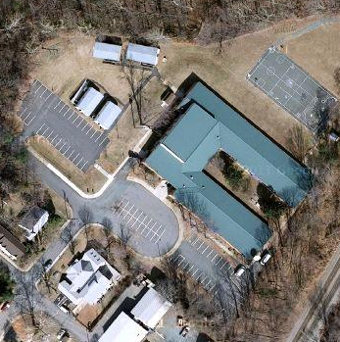
    PARITY PROJECTS
    Enterprise/ISAEP Program
    Issue:
    The Enterprise & ISAEP Programs are currently held in four trailers outside of Murray High School.
    Solution:
    Relocate Albemarle Resource Center and renovate classrooms to accommodate Enterprise & ISAEP programs inside the building.
    Estimated Cost: $529,000
Capital Improvement Program FY13/14-17/18 August 23rd, 2012

Slide 22

    PARITY PROJECTS
    Red Hill Elementary
    Issue:
    The school was built in the 1970’s. It does not benefit from the same amenities of other schools in the division. It’s media center is undersized, administration area is insufficient, art & music are held in trailers and all classrooms need renovation.
    Building Capacity: 160 Media Center Size: 101 students
    2011/12 Enrollment: 174 Gym Size: ½ the size of a full gym
    Projected 5 year Enrollment: 187 Trailers: 4
    Solution:
    Construct additions to provide an art room, music room, new administration area, expanded media center & expanded gym. Renovate spaces inside the building to modernize the space.
    Estimated Cost: $5,304,000
Capital Improvement Program FY13/14-17/18 August 23rd, 2012

Slide 23

    PARITY PROJECTS
    Yancey Elementary
    Issue:
    The school was built in the 1960’s. It does not benefit from the same amenities of other schools in the division.
    Building Capacity: 135 Media Center Size: 155 students
    2011/12 Enrollment: 147
    Projected 5 year Enrollment: 167
    Solution:
    Renovate existing building to modernize space.
    Estimated Cost: $2,153,606
    Construct a classroom addition & expand media center.
    Estimated Cost: $ 2,995,496
Capital Improvement Program FY13/14-17/18 August 23rd, 2012

Slide 24

    PARITY PROJECTS
    Western Albemarle High School
    Issue:
    The school was built in the 1970’s. It does not benefit from the same amenities of other schools in the division & some areas need to be modernized.
    Building Capacity: 1114 2011/12 Enrollment: 1034 Projected 5 year Enrollment: 1134
    Solution:
    Upgrade food service area to add walk-in refrigeration and freezer units & improve preparation areas.
    Estimated Cost: $267,000
Construct new entrance canopy and re‐face the front of the main entrance ; renovate and expand administrative space; construct new forum space.
Estimated Cost: $ 1,924,000
Capital Improvement Program FY13/14-17/18 August 23rd, 2012

Slide 25
    Learning space Projects

Slide 26
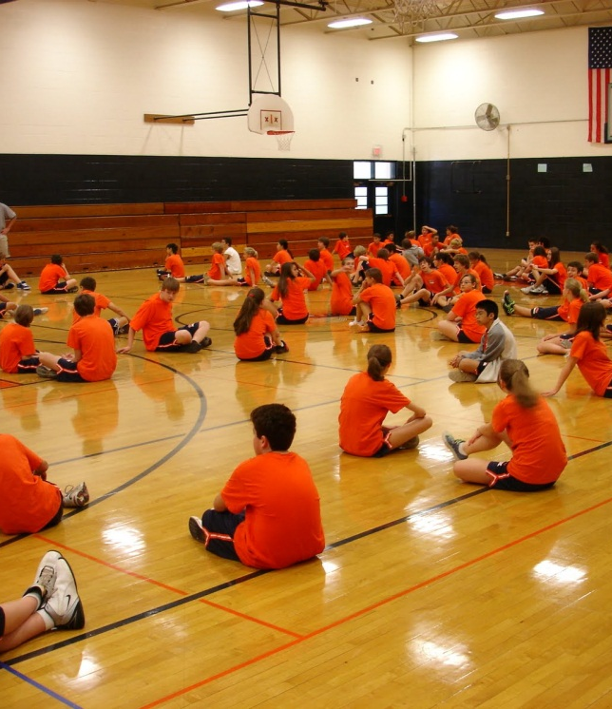
    LEARNING SPACE PROJECTS
    Henley Middle School
    Issue:
    The gym & media center are undersized for a school of such a large school. The school does not have a meeting space for large groups.
    2011/12 Enrollment: 804
    Projected 5 year Enrollment: 906
    Media Center Size: 655 students
    Solution:
    Construct a new auxiliary gym and expand media center:
    Estimated Cost: $3,252,000
    Create forum space in old admin area and construct a new admin area:
    Estimated Cost: $1,796,000
Capital Improvement Program FY13/14-17/18 August 23rd, 2012

Slide 27
    LEARNING SPACE PROJECTS
    Contemporary Learning Spaces
    Issue:
    Spaces need to evolve to meet the needs of the 21st Century Student. The School Board has identified “support for developing Contemporary Learning Spaces” as one of its top three areas of high priority focus within the Albemarle County Public Schools 2011-2013 Strategic Plan.
    Solution:
    Fund needed small, contemporary renovations and refurbishments of existing school classrooms, libraries, and other elective and support areas.
    Estimated Cost: $250,000/year
Capital Improvement Program FY13/14-17/18 August 23rd, 2012

Slide 28
HOW TO SPEND $7 MILLION
CAPACITY PROJECTS | PARITY PROJECTS | LEARNING SPACE PROJECTS
Agnor-Hurt Addition $4.5 m | Enterprise Renovation $0.5 m | Henley Gym Addition $2.25 m
Crozet Addition $5.5 m | Red Hill Modernization $5.25 m | Henley Media Center Expansion $0.75 m
Stony Point Addition $2.0 m | Yancey Modernization $2.0 m | Henley Large Group Meeting Space $1.75 m
Land for Future School $8.0 m | Yancey Addition $3.0 m | Contemporary Learning Spaces $0.25 m/year
 | WAHS Kitchen Upgrades $.25m
 | WAHS Modernization $2.0m

Slide 30
ALTERNATE 5 YEAR CAPITAL PLAN
PROJECT |  |  | YEAR
RANK | School/Department | Description | 2013/14 | 2014/15 | 2015/16 | 2016/17 | 2017/18 | Subtotal
1 | Building Services | Maintenance | 5,560 | 5,323 | 4,755 | 5,288 | 5,812 | 26,738
2 | Technology | State Technology Grant | 752 | 752 | 752 | 752 | 752 | 3,760
3 | Technology | Instructional Technology | 575 | 575 | 575 | 650 | 650 | 3,025
4 | Technology | Administrative Technology | 183 | 261 | 261 | 261 | 263 | 1,229
5 | Technology | Telecom. Network Upgrade | 900 |  |  |  | 900 | 1,800
6 | Transportation | School Bus Replacement | 1,475 | 1,525 | 1,630 | 1,738 | 1,674 | 8,042
7 | Various | Storage Lease | 150 | 155 | 159 | 164 | 168 | 796
(8) | Yancey | Purchase Land +Install Septic | 0 |  |  |  |  | 0
 |  | Roof & HVAC Maintenance | 0 | 0 |  |  |  | 0
 |  | Modernization + Addition | 0 | 0 |  |  |  | DEFER
8 (9) | Murray High School | Phase 1: Renovations | 529 |  |  |  |  | 529
9 (13) | Agnor-Hurt | Addition | 372 | 4,087 |  |  |  | 4,459
10 (14) | Crozet | Addition |  | 449 | 5,216 |  |  | 5,665
11 (16) | Various | Contemporary Learning Spaces | 250 | 250 | 0 | 0 | 0 | 500
12 (10) | Henley | Gym/Media Center & Large Group Space |  |  | 227 | 3025 | 0 | 3,252
13 (11) | Red Hill | Modernization + Remove Trailers |  |  |  | 480 | 5,289 | 5,768
14 (17) | Western Albemarle | Kitchen Upgrades & Modernization |  | 24 | 244 | 0 | 0 | 268
15 (12) | Future | Land for Northern Complex | 0 | 0 | 0 |  |  | DEFER
16 (15) | Stony Point | Addition |  |  | 0 | 0 |  | DEFER
TOTAL |  |  | 10,746 | 13,401 | 13,813 | 12,357 | 15,508 | 65,831
Moved to maintenance
Moved to maintenance

